Slide 1
Strategic Management
Chapter
8

Slide 2
L E A R N I N G O U T L I N E
Follow this Learning Outline as you read and study this chapter.
The Importance of Strategic Management
  Define strategic management, strategy, and business model.
  Explain why strategic management is important.
The Strategic Management Process
  List the six steps in the strategic management process.
  Describe what managers do during external and internal analyses.
  Explain the role of resources, capabilities, and core competencies.
  Define strengths, weaknesses, opportunities, and threats.

Slide 3
L E A R N I N G O U T L I N E (cont’d)
Follow this Learning Outline as you read and study this chapter.
Types of Organizational Strategies
  Describe the three major types of corporate strategies.
  Discuss the BCG matrix and how it’s used.
  Describe the role of competitive advantage in business-level strategies.
  Explain Porter’s five forces model.
  Describe Porter’s three generic competitive strategies and the rule of three.

Slide 4
L E A R N I N G O U T L I N E (cont’d)
Follow this Learning Outline as you read and study this chapter.
Strategic Management in Today’s Environment
  Explain why strategic flexibility is important.
  Describe strategies applying e-business techniques.
  Explain what strategies organizations might use to become more customer oriented and to be more innovative.

Slide 5
Strategic Management
What managers do to develop the organization’s strategies.
Strategies
The decisions and actions that determine the long-run performance of an organization.

Slide 6
Strategic Management (cont’d)
Business Model
  Is a strategic design for how a company intends to profit from its strategies, work processes, and work activities.
  Focuses on two things:
    Whether customers will value what the company is providing.
    Whether the company can make any money doing that.

Slide 7
Why is Strategic Management Important
It results in higher organizational performance.
It requires that managers examine and adapt to business environment changes.
It coordinates diverse organizational units, helping them focus on organizational goals.
It is very much involved in the managerial decision-making process.

Slide 8
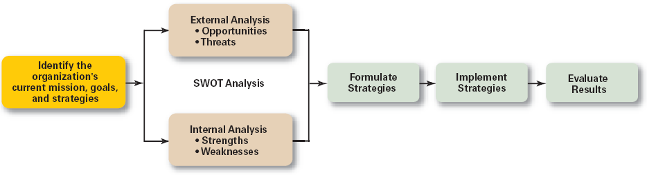
Exhibit 8–1 The Strategic Management Process

Slide 9
Strategic Management Process
Step 1: Identifying the organization’s current mission, goals, and strategies
  Mission: the firm’s reason for being
    The scope of its products and services
  Goals: the foundation for further planning
    Measurable performance targets
Step 2: Doing an external analysis
  The environmental scanning of specific and general environments
    Focuses on identifying opportunities and threats

Slide 10
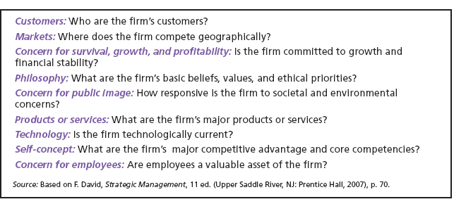
Exhibit 8–2 Components of a Mission Statement
Source: Based on F. David, Strategic Management, 11 ed. (Upper Saddle River, NJ: Prentice Hall, 2007), p.70.

Slide 11
Strategic Management Process (cont’d)
Step 3: Doing an internal analysis
  Assessing organizational resources, capabilities, and activities:
    Strengths create value for the customer and strengthen the competitive position of the firm.
    Weaknesses can place the firm at a competitive disadvantage.
  Analyzing financial and physical assets is fairly easy, but assessing intangible assets (employee’s skills, culture, corporate reputation, and so forth) isn’t as easy.
Steps 2 and 3 combined are called a SWOT analysis. (Strengths, Weaknesses, Opportunities, and Threats)

Slide 12
Exhibit 8–3 Corporate Rankings (partial lists)
Interbrand/BusinessWeek
100 Top Global Brands (2005)
Hay Group/Fortune
America’s Most Admired Companies (2006)
1. Coca-Cola
2. Microsoft
3. IBM
4. General Electric
5. Intel
1. General Electric
2. FedEx
3. Southwest Airlines
4. Procter & Gamble
5. Starbucks
Harris Interactive/Wall Street Journal
National Corporate Reputation (2005)
Great Place to Work Institute/Fortune
100 Best Companies to Work For (2006)
1. Johnson & Johnson
2. Coca-Cola
3. Google
4. United Parcel Service
5. 3M Company
1. Genentech
2. Wegman’s Food Markets
3. Valero Energy
4. Griffin Hospital
5. W. L. Gore & Associates
Sources: “America’s Most Admired Companies,” Fortune, February 22, 2006, p. 65; “The 100 Best Companies to Work For,” Fortune, January 11, 2006, p. 89; R. Alsop, “Ranking Corporate Reputations,” Wall Street Journal, December 6, 2005, p. B1; and “The 100 Top Brands,” BusinessWeek, August 1, 2005, p. 90.

Slide 13
Strategic Management Process (cont’d)
Step 4: Formulating strategies
  Develop and evaluate strategic alternatives
  Select appropriate strategies for all levels in the organization that provide relative advantage over competitors
  Match organizational strengths to environmental opportunities
  Correct weaknesses and guard against threats

Slide 14
Strategic Management Process (cont’d)
Step 5: Implementing strategies
  Implementation: effectively fitting organizational structure and activities to the environment.
  The environment dictates the chosen strategy; effective strategy implementation requires an organizational structure matched to its requirements.
Step 6: Evaluating results
  How effective have strategies been?
  What adjustments, if any, are necessary?

Slide 15
Types of Organizational Strategies
Corporate Strategies
  Top management’s overall plan for the entire organization and its strategic business units
Types of Corporate Strategies
  Growth: expansion into new products and markets
  Stability: maintenance of the status quo
  Renewal: redirection of the firm into new markets

Slide 16
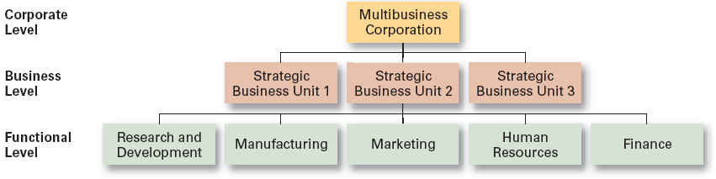
Exhibit 8–4 Levels of Organizational Strategy

Slide 17
Corporate Strategies
Growth Strategy
  Seeking to increase the organization’s business by expansion into new products and markets.
Types of Growth Strategies
  Concentration
  Vertical integration
  Horizontal integration
  Diversification

Slide 18
Growth Strategies
Concentration
  Focusing on a primary line of business and increasing the number of products offered or markets served.
Vertical Integration
  Backward vertical integration: attempting to gain control of inputs (become a self-supplier).
  Forward vertical integration: attempting to gain control of output through control of the distribution channel or provide customer service activities (eliminating intermediaries).

Slide 19
Growth Strategies (cont’d)
Horizontal Integration
  Combining operations with another competitor in the same industry to increase competitive strengths and lower competition among industry rivals.
Related Diversification
  Expanding by combining with firms in different, but related industries that are “strategic fits.”
Unrelated Diversification
  Growing by combining with firms in unrelated industries where higher financial returns are possible.

Slide 20
Growth Strategies (cont’d)
Stability Strategy
  A strategy that seeks to maintain the status quo to deal with the uncertainty of a dynamic environment, when the industry is experiencing slow- or no-growth conditions, or if the owners of the firm elect not to grow for personal reasons.

Slide 21
Growth Strategies (cont’d)
Renewal Strategies
  Developing strategies to counter organization weaknesses that are leading to performance declines.
    Retrenchment: focusing of eliminating non-critical weaknesses and restoring strengths to overcome current performance problems.
    Turnaround: addressing critical long-term performance problems through the use of strong cost elimination measures and large-scale organizational restructuring solutions.

Slide 22
Corporate Portfolio Analysis
Managers manage portfolio (or collection) of businesses using a corporate portfolio matrix such as the BCG Matrix.
BCG Matrix
  Developed by the Boston Consulting Group
  Considers market share and industry growth rate
  Classifies firms as:
    Cash cows: low growth rate, high market share
    Stars: high growth rate, high market share
    Question marks: high growth rate, low market share
    Dogs: low growth rate, low market share

Slide 23
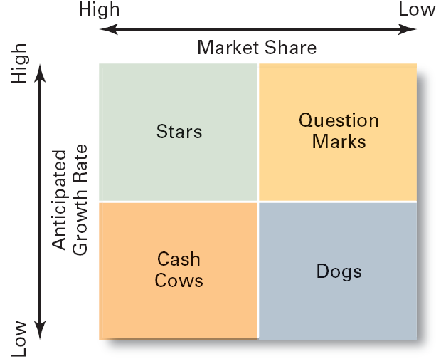
Exhibit 8–5 The BCG Matrix

Slide 24

Business or Competitive Strategy
Business (or Competitive) Strategy
  A strategy focused on how an organization should compete in each of its SBUs (strategic business units).

Slide 25
The Role of Competitive Advantage
Competitive Advantage
  An organization’s distinctive competitive edge.
Quality as a Competitive Advantage
  Differentiates the firm from its competitors.
  Can create a sustainable competitive advantage.
  Represents the company’s focus on quality management to achieve continuous improvement and meet customers’ demand for quality.

Slide 26

The Role of Competitive Advantage (cont’d)
Sustainable Competitive Advantage
  Continuing over time to effectively exploit resources and develop core competencies that enable an organization to keep its edge over its industry competitors.

Slide 27
Five Competitive Forces
Threat of New Entrants
  The ease or difficulty with which new competitors can enter an industry.
Threat of Substitutes
  The extent to which switching costs and brand loyalty affect the likelihood of customers adopting substitutes products and services.
Bargaining Power of Buyers
  The degree to which buyers have the market strength to hold sway over and influence competitors in an industry.

Slide 28
Five Competitive Forces
Bargaining Power of Suppliers
  The relative number of buyers to suppliers and threats from substitutes and new entrants affect the buyer-supplier relationship.
Current Rivalry
  Intensity among rivals increases when industry growth rates slow, demand falls, and product prices descend.

Slide 29
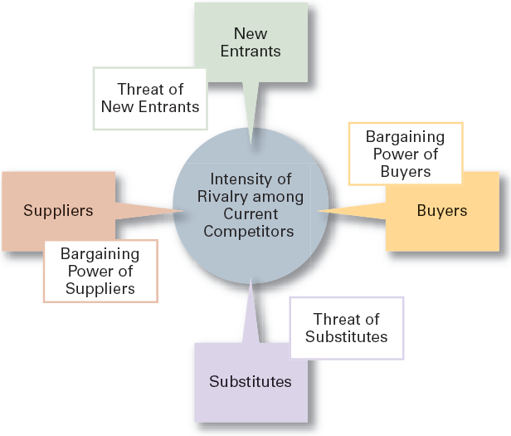
Exhibit 8–6 Forces in the Industry Analysis
Source: Based on M.E. Porter, Competitive Strategy: Techniques for Analyzing Industries and Competitors (New York: The Free Press, 1980).

Slide 30
Types of Competitive Strategies
Cost Leadership Strategy
  Seeking to attain the lowest total overall costs relative to other industry competitors.
Differentiation Strategy
  Attempting to create a unique and distinctive product or service for which customers will pay a premium.
Focus Strategy
  Using a cost or differentiation advantage to exploit a particular market segment rather a larger market.

Slide 31
The Rule of Three
Similar to Porter’s generic competitive strategies
  The competitive forces in an industry will create a situation where three companies (full-line generalists) will dominate a market.
  Some firms in the market become “super niche players” and while others end up as “ditch dwellers.”
  Firms unable to develop either a cost or differentiation advantage become “stuck in the middle” and lack prospects for long-term success.
  A few firms successfully pursue both differentiation and cost advantages.

Slide 32
Strategic Management Today
Strategic Flexibility
New Directions in Organizational Strategies
  e-business
  customer service
  innovation

Slide 33
Exhibit 8–7 Creating Strategic Flexibility
Know what’s happening with strategies currently being used by monitoring and measuring results.
Encourage employees to be open about disclosing and sharing negative information.
Get new ideas and perspectives from outside the organization.
Have multiple alternatives when making strategic decisions.
Learn from mistakes.
Source: Based on K. Shimizu and M. A. Hitt, “Strategic Flexibility: Organizational Preparedness to Reverse Ineffective Strategic Decisions,” Academy of Management Executive, November 2004, pp. 44–59.

Slide 34
How the Internet Has Changed Business
The Internet allows businesses to:
  Create knowledge bases that employees can tap into anytime, anywhere.
  Turn customers into collaborative partners who help design, test, and launch new products.
  Become virtually paperless in specific tasks such as purchasing and filing expense reports.
  Manage logistics in real time
  Change the nature of work tasks throughout the organization.

Slide 35
Strategies for Applying e-Business Techniques
Cost Leadership
  On-line activities: bidding, order processing, inventory control, recruitment and hiring
Differentiation
  Internet-based knowledge systems, on-line ordering and customer support
Focus
  Chat rooms and discussion boards, targeted web sites

Slide 36

Customer Service Strategies
Giving the customers what they want.
Communicating effectively with them.
Providing employees with customer service training.

Slide 37
Innovation Strategies
Possible Events
  Radical breakthroughs in products.
  Application of existing technology to new uses.
Strategic Decisions about Innovation
  Basic research
  Product development
  Process innovation
First Mover
  An organization that brings a product innovation to market or use a new process innovations

Slide 38
Exhibit 8–8 First-Mover Advantages–Disadvantages
Advantages
  Reputation for being innovative and industry leader
  Cost and learning benefits
  Control over scarce resources and keeping competitors from having access to them
  Opportunity to begin building customer relationships and customer loyalty
Disadvantages
  Uncertainty over exact direction technology and market will go
  Risk of competitors imitating innovations
  Financial and strategic risks
  High development costs

Slide 39
Terms to Know
strategic management
strategies
business model
strategic management process
mission
opportunities
threats
resources
capabilities
core competencies
strengths
weaknesses
SWOT analysis
corporate strategy
growth strategy
related diversification
unrelated diversification
stability strategy
renewal strategy
retrenchment strategy
turnaround strategy
BCG matrix
business or competitive strategy
strategic business units
competitive advantage

Slide 40
Terms to Know (cont’d)
cost leadership strategy
differentiation strategy
focus strategy
stuck in the middle
functional strategies
strategic flexibility
first mover

